Slide 1
Finding Your Leverage Point for Making Change
Food Systems Leadership Network
Feb 6, 2023

Slide 2
Welcome! Introduce Yourself in Chat…

Slide 3
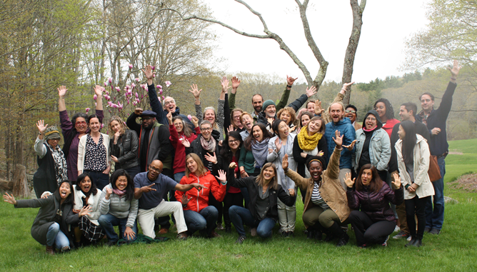
A national peer learning community that connects current and emerging leaders, strengthens individual and collective leadership capacity, and fosters collaboration across communities.
By 2025, 5,000 food systems leaders will have more resources, relationships, and power to realize equitable food systems that generate good food, health, and opportunity for all.

Slide 4
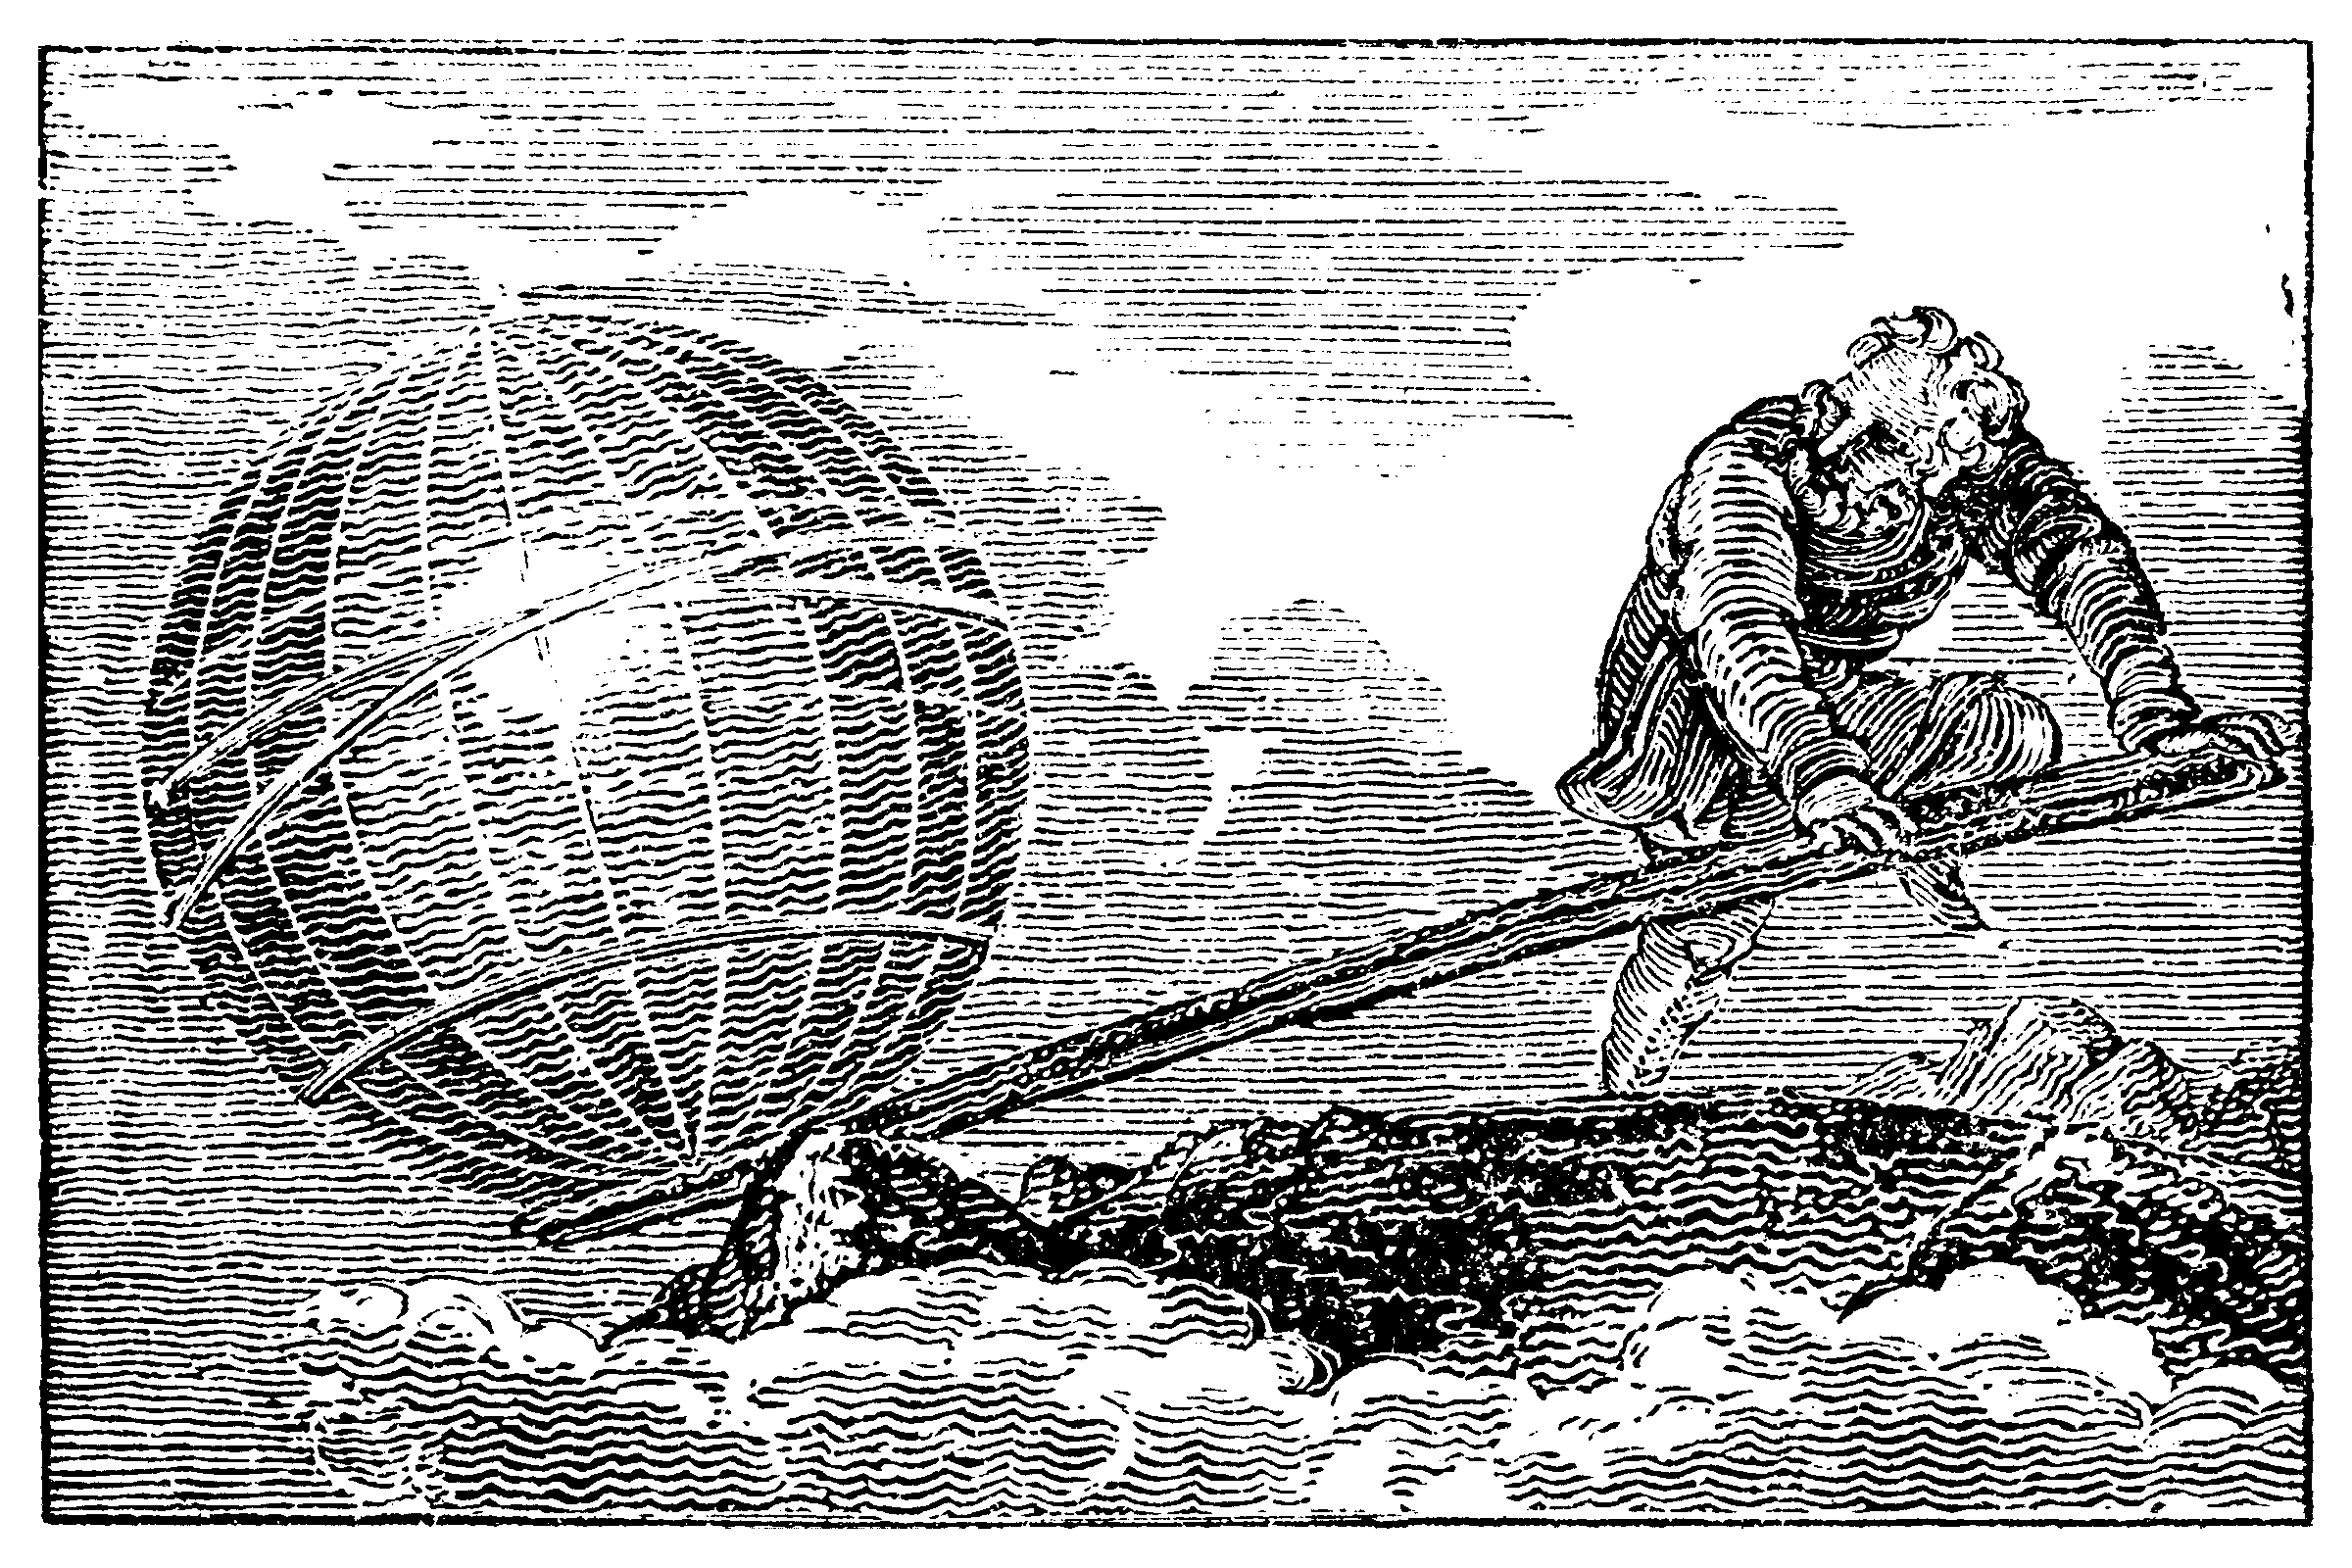
Engraving: Mechanic’s Magazine (cover of bound Volume II,
Knight & Lacey, London, 1824)
GIVE ME A PLACE TO STAND AND I WILL MOVE THE EARTH: Archimedes of Syracuse

Slide 5
“In a fractal conception, I am a cell-sized unit of the human organism, and I have to use my life to leverage a shift in the system by how I am, as much as with the things I do. This means actually being in my life, and it means bringing my values into my daily decision making. Each day should be lived on purpose.”
adrienne maree brown, emergent strategy, page 54
Notes:
Emergent Strategy: Shaping Change, Changing Worlds, by Adrienne Maree Brown (2017)

Slide 6
Folks who do systems analysis have a great belief in “leverage points.” These are places within a complex system (a corporation, an economy, a living body, a city, an ecosystem) where a small shift in one thing can produce big changes in everything.
Donella Meadows, Places to Intervene In A system, Page 3
Notes:
Leverage Points: Places to Intervene in a System. Donella Meadows. The Sustainability Institute. 1999.
Much of this presentation is based on this seminal article.

Slide 7
Reflection Point:
What Does Leverage Mean To You? When Have You Experienced It?
Share in Chat

Slide 8
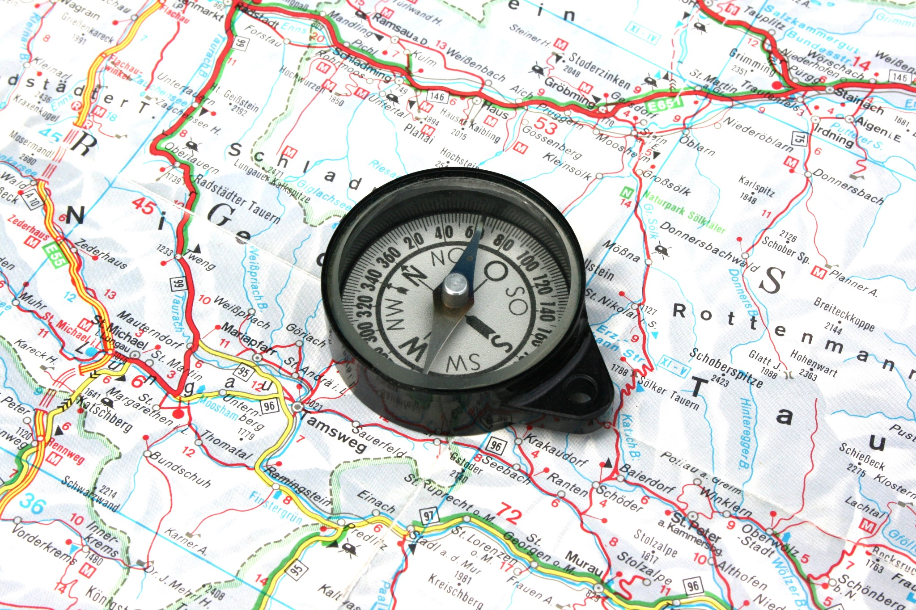
Our Roadmap Today
Key concepts in leverage thinking
Leverage points in food systems
Questions and hopefully answers

Slide 9
Core Concepts For Leverage Point Thinking
Notes:
Here we discuss elements of systems thinking, which is one way to understand the world
Systems thinking has its origins in work to understand ecology and how all elements of the natural world are interrelated and interdependent (see Ludwig von Bertalanffy)
This understanding of interrelatedness and interdependence is something that indigenous cultures around the world have known and acted on for thousands of years
Consider systems thinking another language you might learn to help you in your work

Slide 10
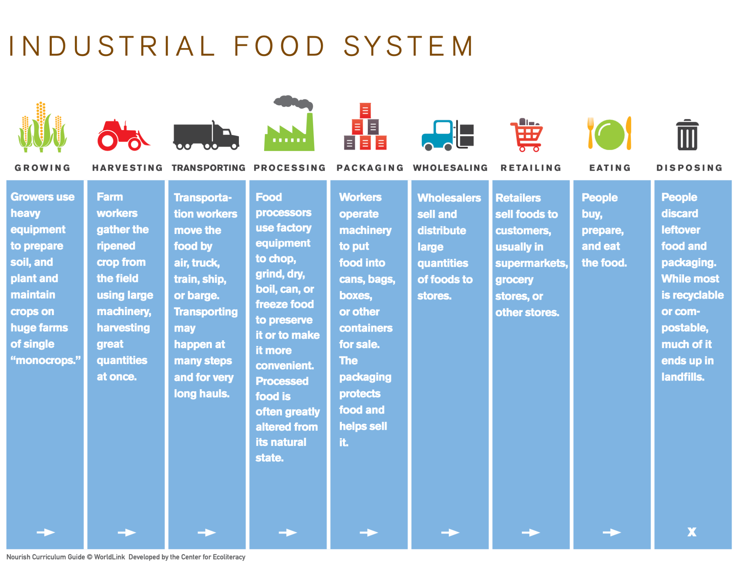
Systems are All Around Us
Clock-like systems
Complicated
Bounded
Solvable
Cloud-like systems
Unpredictable
Hard to control
Evolving
Worked on indirectly
Systems are not separate:
we draw the boundaries

Slide 11
Iceberg Model: look Underneath To Find Leverage
Events
What we see day to day, on the news, and in our communities.
Patterns of Behavior
The trends over time. Things we capture in statistics and histories.
Systems Structures
How the parts of the systems are related? What drives the patterns. Where we see feedback loops.
Mental Models
What values, assumptions, and beliefs shape the system. Where it originated.

Slide 12
Finding Leverage Points: Where we are Trying to Make Change
Acres of land producing for local market
New acres
Leaving acres
Inflows
Our Goal
Outflows
# of community members who are food insecure
Becoming insecure
Leaving insecurity

Slide 13
Seven Principles for Leverage Point Thinking
All systems have multiple leverage points
There is no one ‘magic’ leverage point, only leverage points that we are more or less able to access
Work on one leverage point often touches other leverage points
Find the leverage points that maximize your impact given your resources, influence, and power
Be prepared for delays; even strong leverage points do not often create immediate change
Learn, iterate, learn again. Grow as you experience leverage at work
Watch for unintended consequences…

Slide 14
What About Power?

Slide 15
All Leverage Points Require Power to Move
Power of all types is used to move a leverage point
The power of large meat-packing firms to dictate animal agriculture
The power of large seed companies to limit seed saving
The power of communities to demand local procurement
Potent leverage points can be used by actors to drive change in the direction they prefer
Healthy eating public service announcements vs. fast food advertising
Land tenure by/for BIPOC communities vs. lack of funding/TA or land resources provided
Power is accountable to its source and pressuring the source can be powerful leverage
Corporations to shareholders
Politicians to their funders
Local NGOs to their communities

Slide 16
Leverage Points: Donella Meadows and Beyond

Slide 17
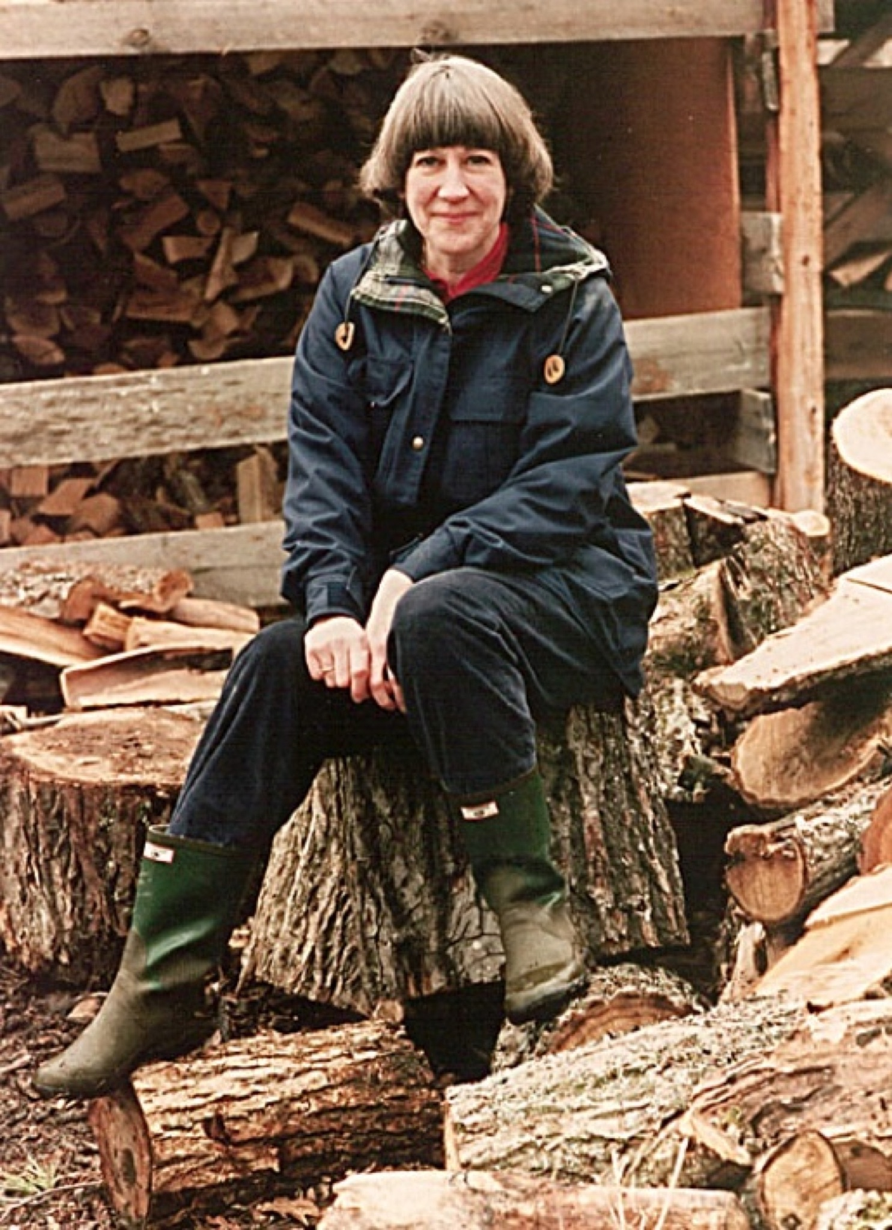
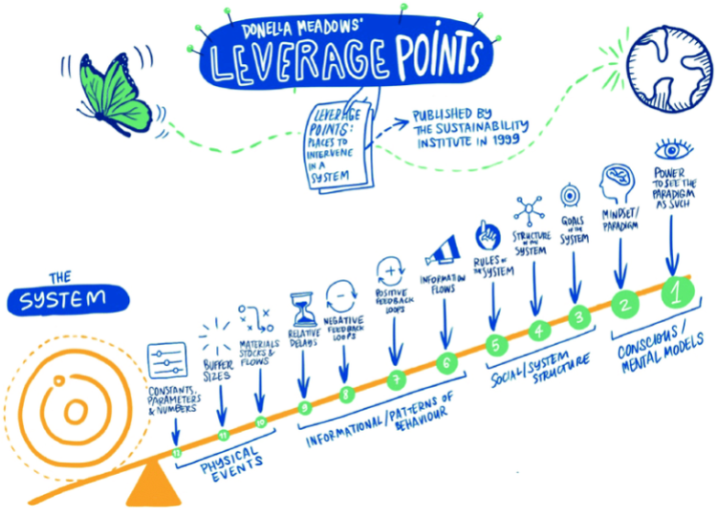
Notes:
Learn more about Donella Meadow at https://donellameadows.org/.

Slide 18
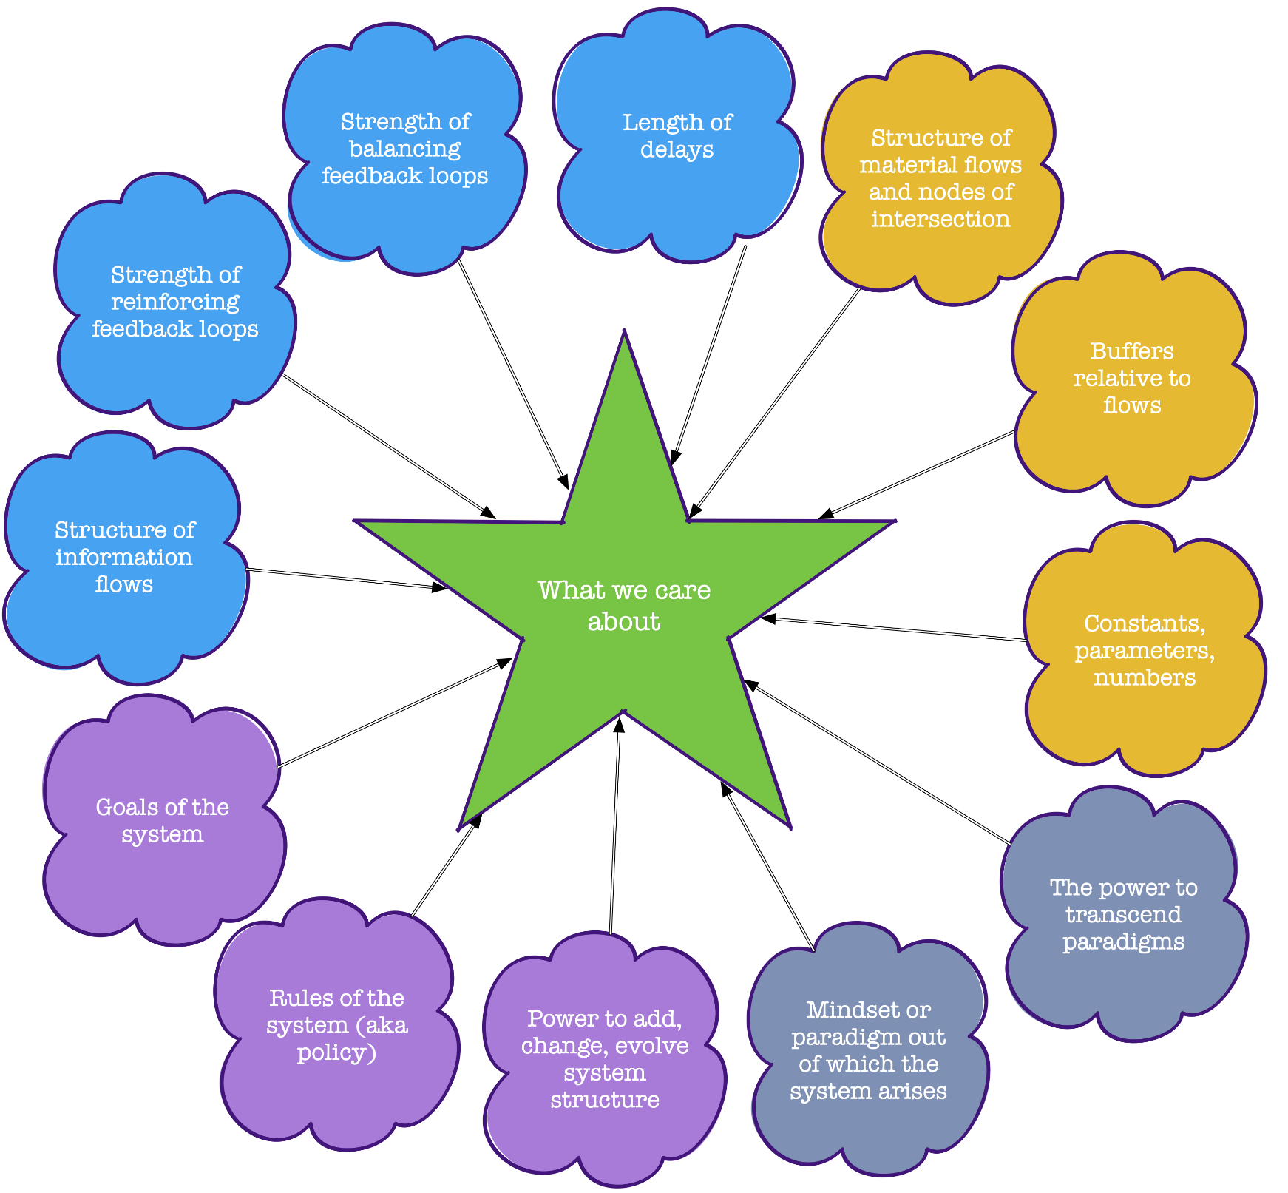
Wheel Model of Leverage points
Notes:
Here we move away from the idea of a hierarchy of where to have the most change or leverage and see how all leverage points interconnect and interrelate. The goal is always to get the most impact out of your unique combination of values, resources, and capacity (i.e. to find where you stand and what length of lever you can wield). Leverage points are based on Meadows, 1999.

Slide 19
Reflection Point:
What is Your Systems Change Goal? What Leverage Points are You Using?
Share in Chat

Slide 20
Leverage Points in Food Systems

Slide 21
The Physical System
Leverage Points
Parameters/numbers
Buffers
Material stocks & flows
Concrete things that shape the food system

Slide 22
Parameters/Numbers
The fixed targets we set to correct injustice in a system
Critically important to us, but… rarely change underlying behavior
Often expensive to change
Require long-term strategies
Can become very powerful as systems reach tipping points
Eg
Fuel efficiency standards
Class size limits
Food system examples
Number of healthy corner stores
Acres of BIPOC-owned land
Size of a sugary beverage tax
Number of wells lost to drought
Amount of C02 emitted
Budget for low-income farmer assistance
Notes:
An important funder trap here, as funders often ask you to “quantify” your impact. This can often force you away from a more powerful leverage point, but one harder to quantify simply.

Slide 23
Buffer Sizes
Some systems are shielded from big changes by buffers, eg stocks of assets that can be used when needed
Big dams buffer against variations in rainfall
Savings accounts buffer against variations in income
The atmosphere’s capacity to absorb pollutants buffers against factory outputs
Usually these are physical, expensive to create and hard to change
Food System Examples
The amount of food held in disaster emergency reserves
Irrigation ponds/rainwater catchment on farms
Healthy soils initiatives

Slide 24
Material Stocks and Flows
This is the physical structure of our built world
Think auto-centered suburbs, freeways, railroad networks
Critically important to how the system works
Difficult to change, often require a multi-generational timeframe and a regional/national approach
Food System Examples
Irrigation infrastructure like canals
Location & scale of processing facilities
Distribution of grocery stores
Silos and other grain/feed storage
Mass market animal ag infrastructure (CAFOs)

Slide 25
Reflection Point:
Food System Physical Structure Levers–What Examples Do You See?
Share in Chat

Slide 26
The Informational Patterns of Behavior Leverage Points
Relative delays
Balancing feedback loops
Reinforcing feedback loops
Information flows
Often the center of strategy

Slide 27
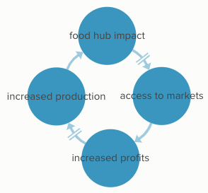
RElative Delays In Impact
In most change efforts there is a delay between the change itself and its impact
Think of adjusting the temperature in a shower
The time it takes for environmental restoration project to mature
How preschool investments in kids payoff decades later
The leverage point here is to reduce these delays
Food Systems Examples
The time between new farmer training and being a successful farmer. Delay reduced by technical/financial assistance.

Slide 28
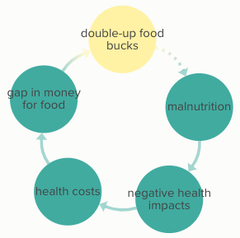
Strength of Balancing Feedback Loops
Balancing feedback attempts to slow undesired outcomes
All reinforcing systems have a balancing element eventually
Speeding tickets for speeders
Progressive income taxes
C02 taxes
Food System Examples
Food banking for hunger relief
Conservation easements for ag land preservation

Slide 29
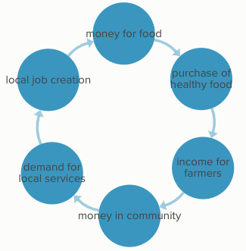
Strength of Reinforcing Loops
Reinforcing loops build on themselves
Can be virtuous or vicious
Time with friends is relaxing and encourages more time there
Success to the successful
Food Systems Examples
Farmers markets increase grower income encouraging more markets
Veggie Rxs encourage healthy eating which improves health and more veggies in diet

Slide 30
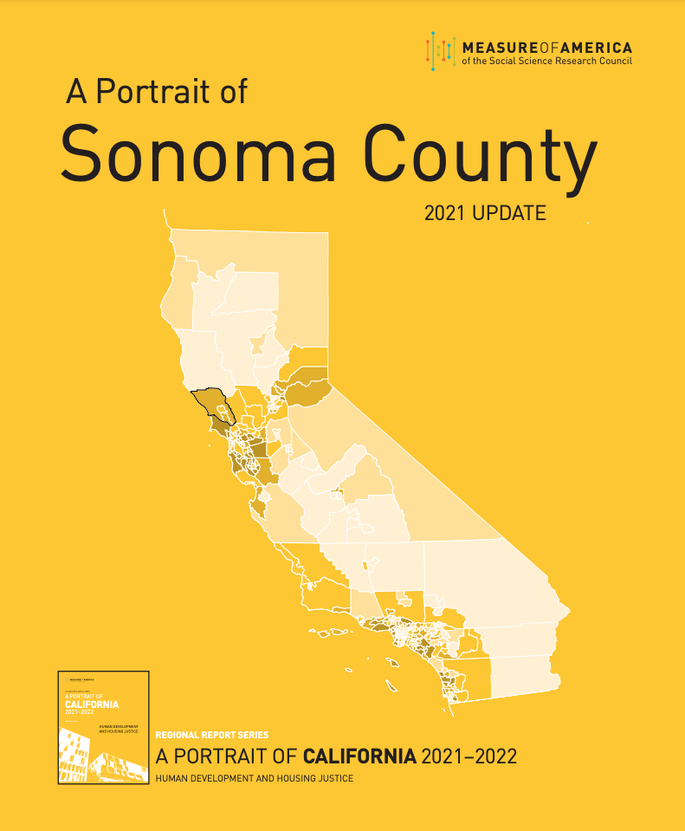
Structure of Information Flows
This is the power of feedback to shape behavior
Simple forms of feedback, like prices, are often misleading
Many tragedy of the commons situations are missing feedback
Lots of ‘data’ out there, but misses having impact due to polarization
Food System Examples
Measure of Americain data on health and disparities
Union of Concerned Scientists 50-State Food System Scorecard
Product nutrition labels
Consumer-facing certification labels
Notes:
CA drought and GW overdraft: the lack of well monitoring data means there is no view on overall extraction of water in a GW basin.
https://measureofamerica.org/
https://www.ucsusa.org/resources/50-state-food-system-scorecard

Slide 31
Mental Break: Shake it Out

Slide 32
The Structure of the System Levers
The rules of the system
The power to evolve system structure
The goals of the system
Powerful and harder to pull

Slide 33
The Rules of the System
Focus of ‘policy’ work
Keeping or eliminating DST
Legalizing or criminalizing cannabis
How dams are operated in drought areas
Obligations of corporations to shareholders
Rules for voting
Funding programs generally do not change the rules
Food System Examples
National Sustainable Ag Coalition work
Open Markets Institute’s Food & Power antitrust/monopoly work
Food policy councils
Local food procurement policies
Zoning and local/regional land use planning
Notes:
National Sustainable Ag Coalition
Open Markets Institute, Food & Power
Food Policy Networks - Johns Hopkins Center for Livable Future

Slide 34
The Power to Evolve, Self-Organize System Structure
In nature, living systems evolve
In human systems, we can evolve all the aspects of the system…if we have the power
This is resilience AKA “emergence” that Octavia Butler and adrienne marie brown describe
Evolution favors diverse systems–domination by one culture or mindset reduces it
Food System Examples
The novel and rapid response of communities during the COVID crisis
BIPOC communities work to rebuild outside the frame of western power
Notes:
Blessed Unrest: How the Largest Movement in the World Came into Being and Why No One Saw It Coming. Hawkin, Paul. 2007.

Slide 35
The Goals of the System
Goals are less about what we say and more about what the system does
Our economic system concentrates power and minimizes competition
Our social system privileges one race over others
Generally goals of a system are hard to shift, except when powerful voices articulate new goals
Food System Examples
Earl Butz to farmers: “Get big or get out”; “Plant from fencerow to fencerow”
Soul Fire Farm: “With deep reverence for the land and wisdom of our ancestors, we work to reclaim our collective right to belong to the earth and to have agency in the food system.”

Slide 36
Reflection Point:
Food Systems Structure Levers:
What Examples do you See?
Share in Chat

Slide 37
The Mental Models of the System Levers
Mindset out of which the paradigm arises
Ability to see/move past inherited paradigms
At the bottom of the iceberg, liberation being

Slide 38
Paradigms and Beyond
Lever: Shifting the mindset out which a system arises
The cis-gen nuclear family as the central family structure
The primacy of white western culture and technology
Inherited wealth is a right
The government is the enemy
Gross national happiness vs gross national product
Lever: Power to transcend paradigms
What is outside popular knowing
What is known by BIPOC cultures that have resisted the western paradigms
What lies beyond our ideas of truth
The land of the emergent and co-created

Slide 39
The Road Ahead: Finding Your Leverage Points

Slide 40
A Six-Step Approach
Understand the system your are working to change
What are its boundaries
How does it work
What drives it
Look for the leverage points anywhere among the 12 (or more that you find)
Evaluate how other players are using the leverage point
Choose to work on the leverage point(s) that you have unique skills and power around
Build coalitions to work leverage points that require collective action
Strengthen personal and collective patience, humility, and awareness
Learn, adjust, learn some more

Slide 41
Questions/Comment
Keep the conversation going on the FSLN Systems Leadership Discussion Group!
Notes:
https://foodsystemsleadershipnetwork.org/groups/systems-leadership/forum/systems-leadership/

Slide 42
Thanks and Acknowledgements
Thanks to
The Wallace Center & the Food System Leadership Network for supporting this session
Katy Mamen for excellent counsel and long friendship
Rachael Reichenbach for ideas on how to link this to the most recent systems leadership work
To all my ancestors, teachers, and guides and in particular Dana Meadows who inspires still
This work is yours to use under the Creative Commons Attribution-NonCommercial-NoDerivatives 4.0 International License
Attribution: Finding Your Leverage Points. Joseph McIntyre. 2023. The Food Systems Leadership Network at the Wallace Center.
You can reach Joseph McIntyre at joseph@10circles.com

